Slide 1


Slide 2
Agenda
Spark Streaming Recap
https://spark.apache.org/docs/latest/structured-streaming-programming-guide.html
https://spark.apache.org/docs/latest/structured-streaming-kafka-integration.html
Setup local environment and testing
Lab time

Slide 3
Spark Streaming Overview
There are two APIs
Older API is Discretized Stream (DStream)
Map, flatMap on RDDs
Newer API is Structured Streaming
SQL on Datasets/DataFrames
Same as batch API!

Slide 4
Structured Streaming API flavors
// Select the devices which have signal more than 10
// using untyped APIs
df.select("device").where("signal > 10")
// using typed APIs
ds.filter(_.signal > 10).map(_.device)
// plain SQL df.createOrReplaceTempView("signals") spark.sql("select device from signals where signal > 10")

Slide 5
Structured Streaming Features
Streaming sources
Selections, Projections, Aggregations
Windowing
Joins
Streaming Sinks
Fault Tolerance
Notes:
Streaming sources like directories of files,
Selection (which rows) and projection (which columns)
SELECT a, b,c is actually a PROJECTION

Slide 6
Terminology
Write-ahead Log (WAL) - an append only file
Source (where data is coming from) and sink (where data is going to)
Selections (which rows), Projections (which columns), Aggregations (combine rows)
Checkpointing - saving your progress
Watermarking - threshold at which events are dropped/kept
Exactly once, at least once, at most once

Slide 7
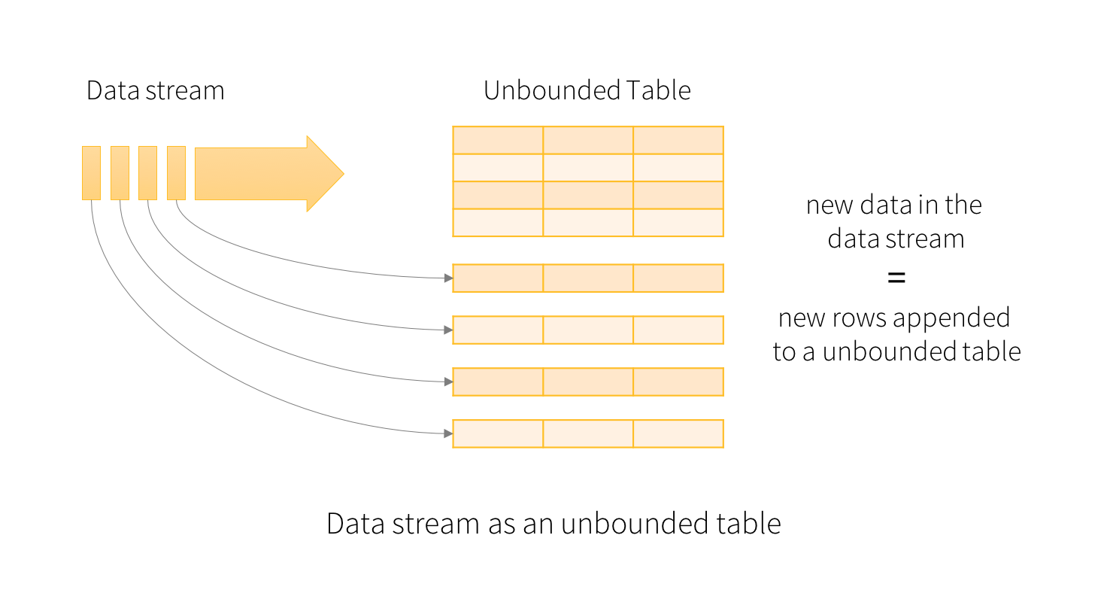
Structured Streaming Basics
Notes:
You will express your streaming computation as standard batch-like query as on a static table, and Spark runs it as an incremental query on the unbounded input table.
Note that Structured Streaming does not materialize the entire table. It reads the latest available data from the streaming data source, processes it incrementally to update the result, and then discards the source data. It only keeps around the minimal intermediate state data as required to update the result (e.g. intermediate counts in the earlier example).

Slide 8
Structured Streaming Inputs
Files from a directory
Kafka
For testing only: Socket / Rate

Slide 9
Structured Streaming Operations
Selection, Projection, Aggregation
Select, where, groupBy as well as map, filter, flatMap
https://spark.apache.org/docs/latest/api/sql/index.html
// Select the devices which have signal more than 10
// using untyped APIs
df.select("device").where("signal > 10")
// using typed APIs
ds.filter(_.signal > 10).map(_.device)
// plain SQL df.createOrReplaceTempView("signals") spark.sql("select device from signals where signal > 10")

Slide 10
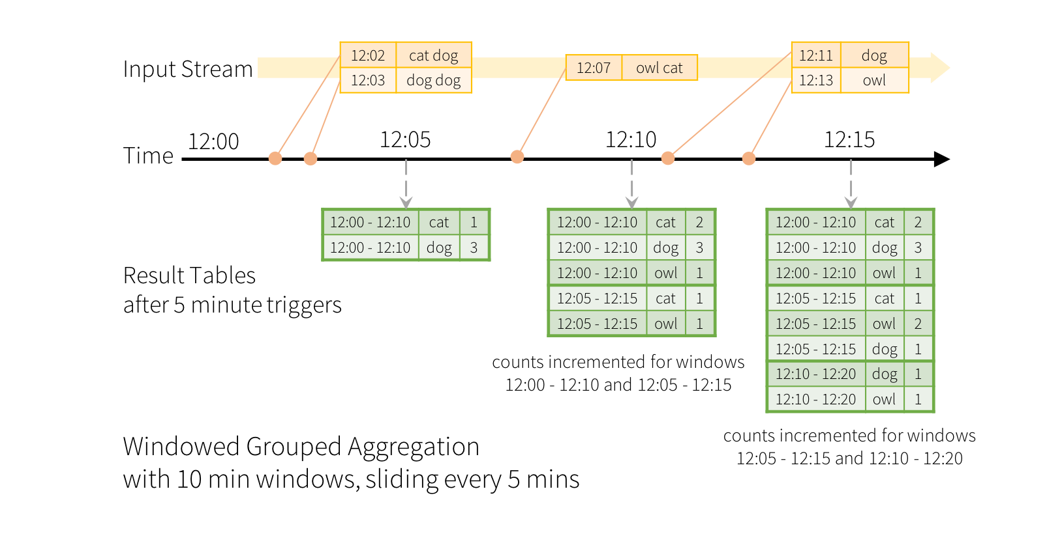
Structured Streaming Windowing
Notes:
Count words within 10 minute windows updating every 5 minutes

Slide 11
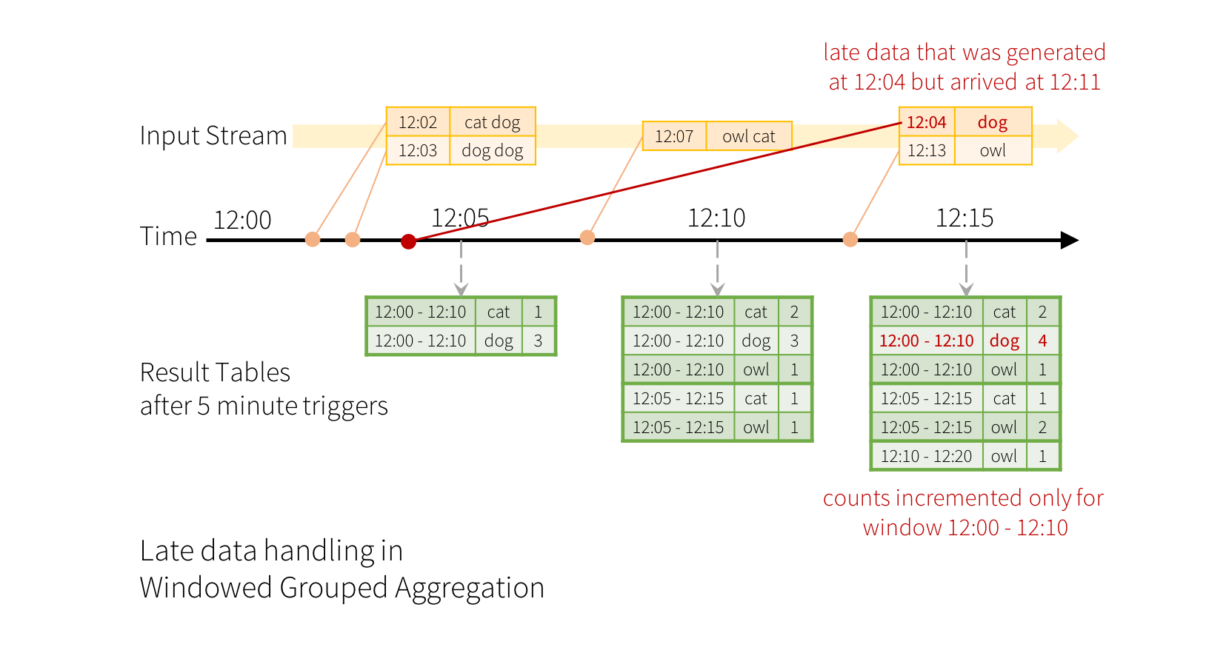
Structured Streaming Windowing
Notes:
Late data and concept of watermarking
Engine automatically track the current event time in the data and attempt to clean up old state accordingly
Must use a timestamp within the data

Slide 12
Structured Streaming Joins
Can join a streaming DataFrame/Dataset with other streaming/static DataFrames/Datasets
Often will need watermarking and time constraints
Inner, Left Outer, Right Outer, Full Outer
import org.apache.spark.sql.functions.expr
val impressions = spark.readStream. ...
val clicks = spark.readStream. ...
// Apply watermarks on event-time columns
val impressionsWithWatermark = impressions.withWatermark("impressionTime", "2 hours")
val clicksWithWatermark = clicks.withWatermark("clickTime", "3 hours")
// Join with event-time constraints
impressionsWithWatermark.join(
clicksWithWatermark,
expr("""
clickAdId = impressionAdId AND
clickTime >= impressionTime AND
clickTime <= impressionTime + interval 1 hour
""")
)

Slide 13
Structured Streaming Outputs
Files
Kafka
Foreach
ForeachBatch
Console
Memory
Notes:
Foreach and foreachBatch - arbitrary operations
ForeachBatch - resuse existing data sources, write to multiple locations

Slide 14
Structured Streaming Output Modes
Append mode (default) - only new rows
Complete mode - entire table
Update mode - only updated rows

Slide 15
Structured Streaming Output Modes
Append mode (default) - only new rows
Complete mode - entire table
Update mode - only updated rows

Slide 16
Structured Streaming Fault Tolerance
Recover from a failure and continue where app left off
Checkpointing
Write-ahead logs
Limitations

Slide 17
Structured Streaming + Kafka
Include Spark SQL Kafka 0.10 library
Read from Kafka / Write to Kafka
val df = spark
.readStream
.format("kafka")
.option("kafka.bootstrap.servers", "host1:port1,host2:port2")
.option("subscribe", "topic1")
.load()
df.selectExpr("CAST(key AS STRING)", "CAST(value AS STRING)")
.as[(String, String)]
val ds = df
.selectExpr("CAST(key AS STRING)", "CAST(value AS STRING)")
.writeStream
.format("kafka")
.option("kafka.bootstrap.servers", "host1:port1,host2:port2")
.option("topic", "topic1")
.start()

Slide 18
Demo: Getting Started
Environment setup
Explore
Test
Run

Slide 19
Lab Time
Environment setup Clone https://github.com/kitmenke/spark-hello-world
What is on the sales topic? What is the schema?
Write a compute function and a test for the compute function that…
Defines a schema
Parses the data into a dataframe
Does an aggregation (your choice)
Integrate this into the main app

